Slide 1
TELNET
Name - Sukdeb Mondal Roll - 340

Slide 2
What is TELNET?
TELNET stands for Teletype Network.
It is a client/server protocol used to access remote computers.
Works on TCP/IP protocol for virtual terminal service.
Local computer = the one starting the connection.
Remote computer = the one being accessed.
Actions on the remote system are shown on the local system.
Based on client/server principle.

Slide 3
Telnet: Origins, Use, and Replacement
Developed in the late 1960s
Created to give remote terminal access to mainframes/minicomputers
Allowed users to connect using command-line interface
It was simple and useful but not secure.
Now replaced by SSH for secure remote access

Slide 4
Technical Details of TELNET
OSI Layer: Application Layer (Layer 7)
Protocol: TCP (Transmission Control Protocol)
Default Port Number: 23
Connection Type: Client/Server
Data Transmission: Plain text (not encrypted)
Supported Services: Remote login, command execution

Slide 5
Logging in TELNET
Local Login
Remote Login

Slide 6
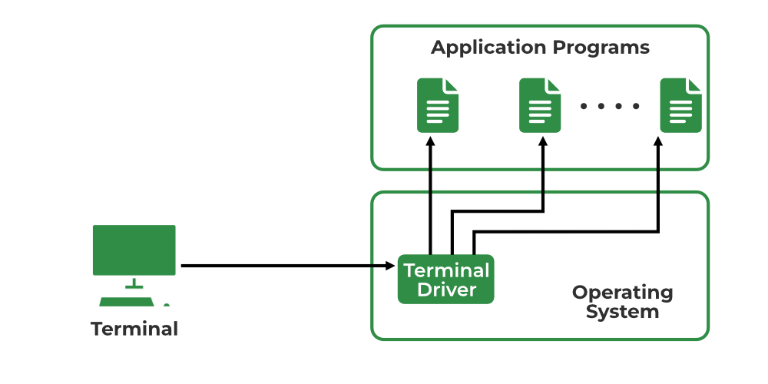
Local login
User logs into their own computer

Slide 7
Procedure of Local Login
User types → Keyboard Input accepted by Terminal Driver
Terminal Driver → sends characters to OS
OS validates input and opens the required application

Slide 8
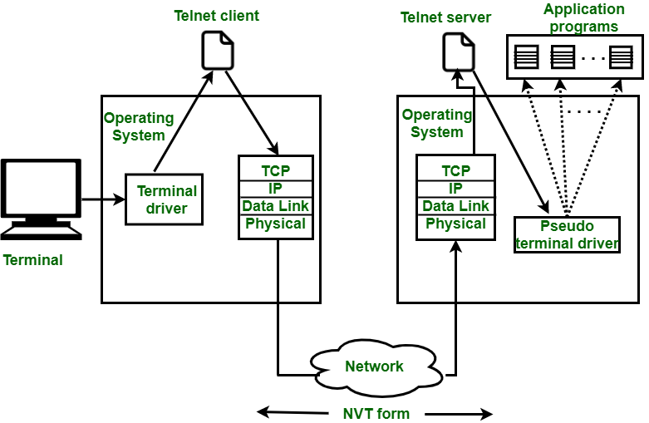
Remote Login
User logs into a remote computer and uses its services

Slide 9
Procedure of Remote Login
User types → Local OS accepts input.
Input sent to TELNET client.
TELNET client converts input into NVT (Network Virtual Terminal) format.
Data sent via TCP/IP stack to remote computer.
Remote TCP/IP stack → passes data to TELNET server.
TELNET server converts data into remote system format.
Remote OS receives input through pseudo-terminal driver.
OS passes input to the required application program.

Slide 10
Network Virtual Terminal(NVT)
A virtual terminal used in TELNET
Provides a common format for communication
Works across different terminals and operating systems
Ensures smooth data exchange between client and server

Slide 11
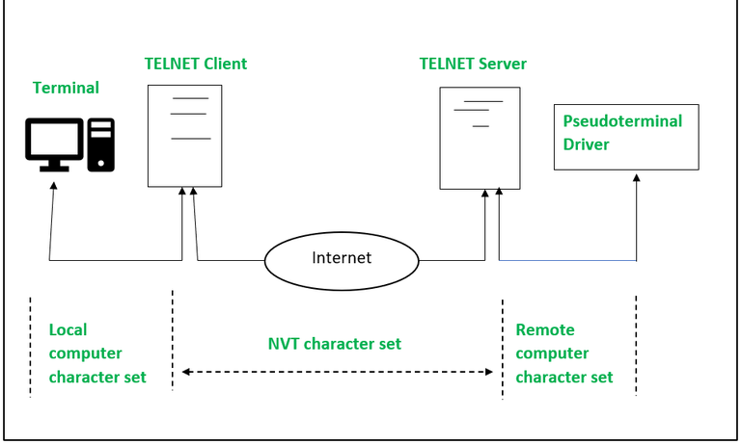
Network Virtual Terminal(NVT) in TELNET

Slide 12
How TELNET Works?
Client–Server Interaction
Client (local computer) sends request to server.
Connection established → client sends commands.
Server processes commands and sends response.
Data Flow
User types → Local OS accepts input.
TELNET client converts input → NVT (Network Virtual Terminal) format.
Data travels via TCP/IP to remote computer.
TELNET server converts NVT → remote system format.
Remote OS passes data to the correct application.
Network Virtual Terminal (NVT)
A virtual terminal in TELNET.
Provides a common structure for all terminals.
Makes different systems work together easily.

Slide 13
Uses of TELNET
Remote Control: Access and manage computers from far away.
Network Checking: Test and fix problems in network connections.
Learning Commands: Practice and understand command-line instructions.
Automation: Make a computer do tasks automatically.

Slide 14
Advantages of TELNET
Remote Access: You can use another computer from far away.
Easy Communication: It works well with fewer problems in sending data.
Time-Saving: You don’t need to be physically present to work on a computer.
Cross-System Connection: Old computers can connect to new computers, even with different operating systems.

Slide 15
Disadvantages of TELNET
Hard for Beginners: It can be complex for new users to understand because requires learning commands and network concepts, which may be confusing.
Not Secure: Data is sent as plain text, so it can be easily seen by others because anyone intercepting the data can read sensitive information like passwords.
Limited Features: Some functions may not work if the local and remote computers aren’t fully compatible.

Slide 16
Modes of Operation
Default Mode: If no other modes are invoked then this mode is used. Echoing is performed in this mode by the client. In this mode, the user types a character and the client echoes the character on the screen but it does not send it until the whole line is completed.
Example:
You type: ls -l
You see: ls -l on your screen
Only after pressing Enter, the command is sent → server shows the list of files.
Character Mode: Each character typed in this mode is sent by the client to the server. A server in this type of mode normally echoes characters back to be displayed on the client's screen.
Example:
You type: pwd
First p is sent → server shows p
Then w is sent → server shows w
Then d is sent → server shows d
Finally, server processes the command.

Slide 17
Modes of Operation
3. Line Mode: Line editing like echoing, character erasing, etc. is done from the client side. The client will send the whole line to the server.
Example:
You type: sl -l (by mistake)
You press Backspace and correct it to ls -l
Only the corrected line ls -l is sent to the server.

Slide 18
Conclusion
Telnet is a client/server application Protocol that allows remote access to virtual terminals via local area networks or the internet. Telnet's use has decreased due to security concerns, with protocols such as SSH chosen for safe remote management. Telnet is still useful for remote administration, network diagnostics, instructional purposes, and interacting with legacy systems.

Slide 19
Thank You

